Slide 1
R for refreshers and extension
Greta Todorova

Slide 2
Quick recap

Slide 3
Tidyverse
Select variables: select(data, variable_names_unquoted)
Keep or remove observations: filter(data, variable_to_check == some_condition)
Create new variables: mutate(data, new_variable_name = what_is_in_the_variable, new_variable_name2 = ...)
Grouping: group_by(data, variable1, variable2,...)
Summarise: summarise(data, summary_variable_name = some_function())
From long to wide: spread(data, key = variable_with_names, value = variabe_with_values, ...)
From wide to long: gather(data, key = "name_for_var_with_labels", value = 'name_for_var_with_values', c(variable1, variable2,...))

Slide 4
Pipes %>%
Pipes feed into each other. Easiest interpretation is to read them as 'then'
Select variable, then, filter rows, then group, then....
It reduces the number of environment objects created
data_new <- data %>% #use data THEN
select(-Variable) %>% #remove variable THEN
filter(variable1 == some_level) %>% #keep only the number of people THEN
group_by(Variable2, Variable3) #group according to variable 2 and variable 3) THEN
summarise(new_variables = sum(variable4)) #create summary

Slide 5
Plots
ggplot(employment, aes(DateCode, Value,
group = Gender,
color = Gender)) + #specify data to plot
geom_col() #choose the type of plot

Slide 6
Deep dive

Slide 7
Lets plot Scotland

Slide 8
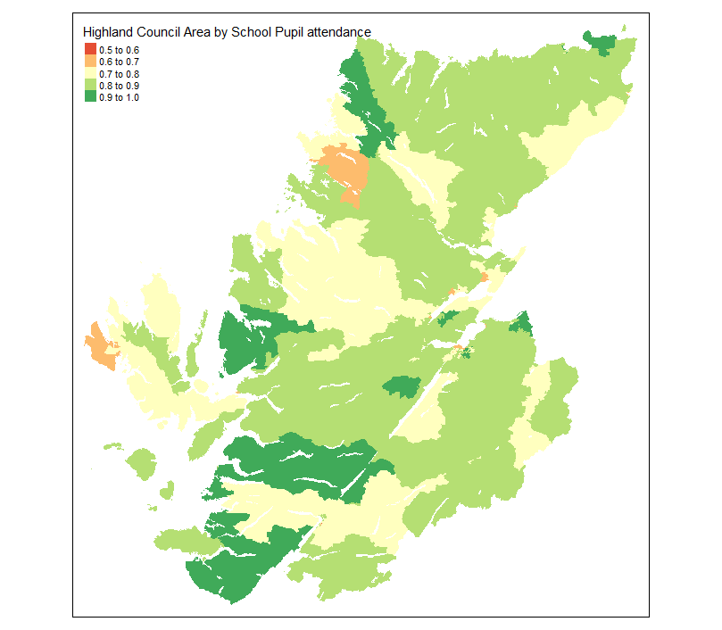
Mapping
Data: https://www2.gov.scot/Topics/Statistics/SIMD
library(tmap)
library(tmaptools)
Works in layers like ggplot2
Layer1: tm_shape() the shape you want to plot
Layer2: tm_function() how do you want to plot
Layer3 etc: optional

Slide 9
Resources
https://dplyr.tidyverse.org/reference/mutate_all.html
https://suzan.rbind.io/2018/02/dplyr-tutorial-3/
https://ggplot2-book.org/polishing.html
My personal favourite: http://www.cookbook-r.com/Graphs/
https://cran.r-project.org/web/packages/tmap/vignettes/tmap-getstarted.html
https://www.johnmackintosh.com/2017-09-01-easy-maps-with-tmap/

